Slide 1
INVESTMENTS
Week 2: Diversification and Portfolio Theory
Vikas Raman

Slide 2
Outline
Risk and return
use of standard deviation as measure of risk
The mathematics of risk and return
the formulae
correlation and diversification
Risk-return space
the feasible set
the efficient frontier
two fund separation
borrowing/lending and single fund
CAPM

Slide 3
Risk
Standard deviation as measure of risk
compute returns, r_{t} ; mean return is:
standard deviation is traditional statistical measure of variability or unpredictability:
Why use standard deviation?
familiar, straightforward
economic reasons (later)
convenient - can compute risk of portfolio from risk and correlations of components (not true for e.g. VAR)

Slide 4
Compounding
A share that has a mean daily return of μ has a mean annual return of (1+μ)²⁵²-1 (assuming 252 trading days to the year), so a mean daily return of 0.1% becomes 28.6% annually
to calculate mean return over some period, only need to know price at beginning and end of period
But volatility compounding is more complicated
daily volatility (standard deviation) of s is a daily variance of s²
if returns are independent, then variances sum, and annual variance is 252s²
so annual volatility is s x √252
daily volatility of 2% is 31.7% annually
but if momentum, or excess volatility annualised volatility of daily and weekly returns may differ

Slide 5
Covariance and Correlation
Given one stock R which has return r_{t} and another S which has return s_{t}, recall that the variance of R’s return is:
The covariance of R’s return with S is:
The correlation of R’s return with S is:
Correlations are dimensionless, and lie between –1 and +1

Slide 6
What do correlations look like?

Slide 7
Portfolio risk and return (N = 2)
Suppose we have 2 assets, and we invest a fraction α₁ in asset 1, and α₂ in asset 2, then
The mean return on the portfolio is the weighted average of the mean returns on each of the assets:
The variance of the portfolio is the weighted sum of the covariances:

Slide 8
Excel Spreadsheet
Mean is 0.2x10% + 0.8x15% = 14%
Variance = 0.2²x20%² + 2x0.3x0.2x0.8x20%x23% + 0.8²x23%² ⁼ 0.039872
StdDev = √0.039872 = 19.97%
Embedded Excel Spreadsheet
Blue is used for inputs, black for numbers calculated by program

Slide 9
Mean and standard deviation of portfolios
Mean is a linear function of the composition of the portfolio
Standard deviation is a convex function
the riskiness of a portfolio is less than the average of its components
this is diversification
Go to Excel!

Slide 10
Risk-return diagrams
Use program to show risk-return trade-off as composition of portfolio changes
Want to move North-West
With less than perfect correlation, get benefits from diversification
For the moment, assume we can short sell freely
Go to Excel!

Slide 11
Diversification Effect
Definition: σ_{P} <= [ω σ_{A} + (1- ω) σ_{B}], 0 < ω <= 1
E[R]
A
What does each of the lines
passing through A and B
represent?
ρ = -1
-1 < ρ < 1
ρ=1
B
Portfolio of A and B
that has σ = 0
0
σ

Slide 12
Correlation and Diversification
When ρ = 1, no diversification effect obtains
When ρ < 1, diversification effect obtains
ρ need not be <0 for diversification effect to obtain!
ρ < 1 is sufficient.
Lower the ρ, better the diversification
If and only if ρ = -1 and ω = σ_{B}/(σ_{A} + σ_{B}), then σ_{P} = 0

Slide 13
Portfolio risk and return
Suppose we have N assets, and we invest a fraction α₁ in asset 1, α₂ in asset 2 etc, then
The mean return on the portfolio is the weighted average of the mean returns on each of the assets:
The variance of the portfolio is the weighted sum of the covariances:

Slide 14
Portfolio risk and return
Can arrange the variances and covariances in a matrix – the variance-covariance matrix

Slide 15
Diversified share portfolio
Want to think about large, diversified portfolios, since this is what institutions typically hold
But complicated and unhelpful to think of what happens with a general variance-covariance matrix (with N shares, the matrix has N(N+1)/2 separate entries – with 50 shares, that amounts to 1275 numbers!)
So have simple model of the market which is symmetric
every share has the same volatility, and every pair of shares has the same correlation
equivalently, all the variances are the same, and all the covariances are the same

Slide 16
Diversified share portfolio
If all equities have volatility (standard deviation of annual returns) of σ and a correlation with every other equity of ρ, an equally weighted portfolio of N shares has volatility:
Portfolio Variance = (1/N)Avg. Variance+((N-1)/N)Avg. Covariance =

Slide 17
Multiple Assets
More realistic case: all the variances are not the same, and all the covariances are not the same
Spreadsheet uses matrix functions – but could equally well write full equation
Programme generates a large number of random portfolios to give idea of feasible set of possibilities

Slide 18
Efficiency
There is a trade-off between risk and return
A portfolio that has the highest possible return for a given level of risk (or the lowest risk for a given return) is (mean-variance) efficient
One particular efficient portfolio is the minimum variance portfolio
The set of efficient portfolios forms a curve in risk-return space, called the mean-variance frontier
The efficient portfolios can be found in Excel using the Solver function
Go to Excel!

Slide 19
Two fund separation
All efficient portfolios can be constructed by mixing just two efficient portfolios
Assumptions:
investors care about the expected return and the standard deviation of returns on their money
they agree about the mean return on each of the assets, and the variance-covariance structure
there are no transaction costs, taxes or restrictions on short positions
Result:
All efficient portfolios are composed of just two funds, with the balance between the two funds depending on the investor’s taste for risk
The converse is also true: all portfolios composed of those two funds are efficient.

Slide 20
When One of the Assets is the Risk-Free Asset
Definition of a Risk-Free Asset: σ_{F} = 0
This definition ensures that E[R_{F}] = R_{F}

Slide 21
Portfolio: Expected Return and Standard Deviation
Denote C a portfolio that combines one risky asset and one risk-free asset; y = allocation to risky asset
Expected Return
Variance and Standard Deviation

Slide 22
Capital Allocation Line
Recall the formula for E[R_{C}] and σ_{C} above
With slight manipulation, we see that
This equation relates E[R_{C}] to σ_{C}
The relationship between E[R_{C}] and σ_{C} is linear
The line has the intercept equal to R_{F}

Slide 23
Capital Allocation Line
Each risky asset (or risky portfolio) has its CAL. Its CAL represents the set of allocations between it and the risk-free asset.
E[R]
C₂
CAL of the RISKY portfolio.
Any portfolio C that consists of
RISKY and the risk-free asset
lies on the same CAL.
E[R_{RISKY}]
RISKY
C₁
C₁: 0 < y < 1; 0 < (1-y) < 1
(long risky, long risk-free)
S_{C1} = S_{C2} = S_{RISKY}
C₂: y > 1; (1-y) < 0
(long risky; short risk-free)
0
σ_{RISKY}
σ

Slide 24
Sharpe Ratio
An important criterion of portfolio performance!
Z
CAL_{Z}
CAL_{W}
W
S_{W}
S_{Z} > S_{W}
Any investor prefers Z to W
S_{Z}
σ

Slide 25
Optimal Portfolio
Can we obtain a better portfolio than Z?
E[R]
Z
CAL_{Z}
O
S_{O}
W
S_{Z}
R_{F}
Portfolio opportunity set for W and Z
σ

Slide 26
Optimal Portfolio
How to allocate my money between W and Z to achieve the best reward-to-variability trade-off?
Can we solve for the optimal allocation mathematically?
This is a calculus problem
Excel Solver will easily find ω* for you
Go to Excel!

Slide 27
One Fund Theorem
With unlimited borrowing/lending at the risk-free rate of interest, and all the previous assumptions, all investors should invest in just one risky fund
People who are risk averse should keep most of their money in the risk-free asset (e.g. T-bills), and only put a little in the fund
People who are happy to take a lot of risk should borrow money and put more than 100% of their wealth into the fund
No reason for cautious people to buy cautious stocks – they should just put less money into stocks

Slide 28
One Fund Theorem
All you need is: O and Rf
E[R]
Z
O
W
O is the optimal portfolio.
R_{F}
Portfolio opportunity set for W and Z
σ

Slide 29
One Fund Theorem & CAPM
One Fund Theorem: Everyone will purchase a single fund of risky assets and may borrow or lend at the risk-free rate
Everyone will use the same fund (because everyone has the same mean, var, and covar)
If everyone uses the same fund, what fund must it be? What does this fund look like?
Enter CAPM!
The fund must equal the market portfolio – the total of every asset in the market (value-weighted mix of all the assets in the world )

Slide 30
CAPM
If everyone should be holding the market (plus cash, or borrowing), then no one holds or wants to hold idiosyncratic risk
it follows that you only get rewarded for holding market risk but not for holding idiosyncratic risk:
you get r_{f} interest for lending money without risk
you get E[r_{M}] for holding the market
which means you get a premium of E[r_{M}] - r_{f} for taking the risk of the market
which means you should get a premium of β(E[r_{M}] - r_{f}) for taking the market risk of a share with a beta of β
which means you should expect a return of
E[r_{Y}] = r_{f} + β(E[r_{M}] - r_{f})
for holding share Y

Slide 31
Systematic vs. Nonsystematic Risk
Nonsystematic (idiosyncratic, firm-specific, unique, diversifiable) risk is the risk that can be eliminated through diversification
Systematic (non-diversifiable, market) risk is the risk that cannot be eliminated through diversification
Total risk includes both systematic and unsystematic risk

Slide 32
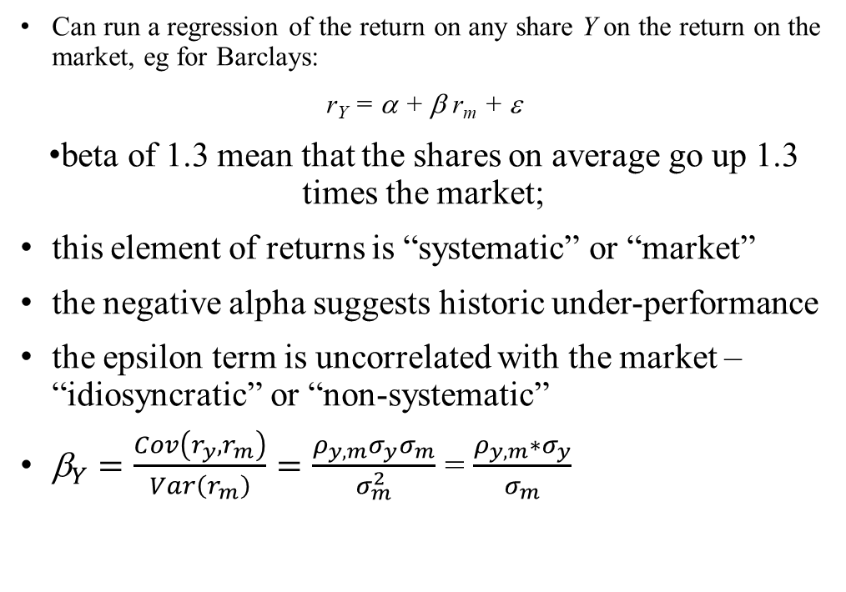
Market risk and idiosyncratic risk I
Can run a regression of the return on any share Y on the return on the market, eg for Barclays:
r_{Y} = α + β r_{m} + ε
beta of 1.3 mean that the shares on average go up 1.3 times the market;
this element of returns is “systematic” or “market”
the negative alpha suggests historic under-performance
the epsilon term is uncorrelated with the market – “idiosyncratic” or “non-systematic”
${\text{b}}_{Y}=\frac{Cov\left(r_{y},r_{m}\right)}{Var\left(r_{m}\right)}=\frac{ρ_{y,m}σ_{y}σ_{m}}{σ_{m}^{2}}$ = $\frac{ρ_{y,m}{∗σ}_{y}}{σ_{m}}$

Slide 33
Market risk and idiosyncratic risk II
Take variance of both sides:
Var[r_{Y}] = Var[α] + Var[β r_{m}] + Var[ε ]
σ_{Y}² = β² σ_{m}² + σ_{ε} ²
so in the case of Barclays share volatility is 2.53% weekly, market volatility is 1.10% and beta is 1.30
2.53² = 1.30² x 1.10² + σ_{ε} ²
giving σ_{ε} = 2.09%
or in other words, the proportion of the variance in Barclays returns that is explained by market returns is {(1.30 x 1.10)/2.53}² = 32%
this is of course the R² of the regression

Slide 34
What the CAPM says
Investors demand a premium (that is a higher expected return) for taking risk
but not all sorts of risk attract a higher return
market risk – that is risks that are correlated with the risk of the market portfolio (as measured by beta) does attract a higher return
other risks, notably idiosyncratic risk, does not attract a premium
Next week will look at empirical evidence, and alternative models
evidence ambivalent, many other models
Key insights
difference between systematic or market risk, and unique or idiosyncratic risk
latter can be avoided by diversification, and attracts no premium
systematic risk does attract a premium, and if CAPM is right, it can be measured by covariance with the market

Slide 35
Security Market Line
CAPM says that all securities (and all portfolios) lie on the Security Market Line
If a share lies above the SML you can add it to the market portfolio and increase expected return without increasing risk
If it lies below, you can short sell it, and improve the market portfolio

Slide 36
Conclusion
Key ideas:
Using standard deviation and mean of returns as measure of risk and reward
Computing the mean and SD of portfolio from the mean, SD and correlation structure of components
Benefits of diversification across assets
Feasible set of portfolios
The efficient frontier
Two fund separation theorem
With borrowing/lending, one fund
CAPM
Beta
Systematic and idiosyncratic risk
Reading
BKM, particularly Chs 7 and 9.1-9.3

